Slide 1
Class and objects

Slide 2
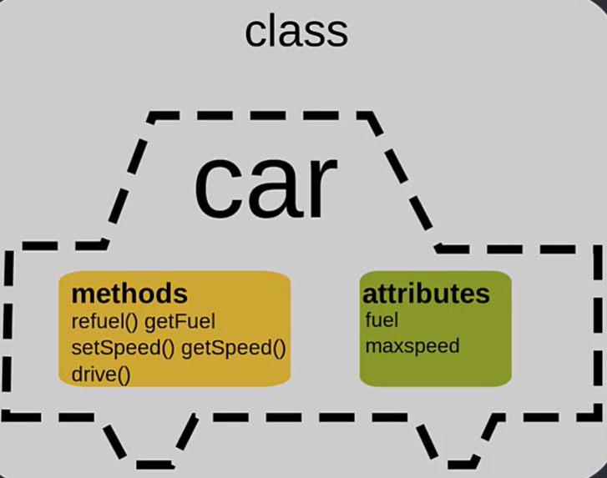
Class
A class is a blueprint or template
It describes what something should look like, but isn't the real thing itself
What a class contains:
Attributes — the data/info it will hold (like name, age, color)
Methods — the actions it can do (like bark, drive, save)
Simple example:
A Dog class might say: "every dog has a name and a breed, and every dog can bark"
That's it — the class is just the definition, nothing is created yet
Why we write classes:
So we don't repeat the same structure over and over
One class = one reusable definition for many future things

Slide 3
Class example
python
class Dog: # Has to be a capital letter
def __init__(self, name, breed):
self.name = name # Attributes
self.breed = breed
def bark(self): # Action
return f"{self.name} says Woof!"
Let's break down what's happening line by line:
class Dog: — this starts the class definition. Dog is the name of our blueprint.
def __init__(self, name, breed): — this is a special method that sets up the initial data whenever the blueprint gets used. name and breed are the attributes this class will hold.
self.name = name and self.breed = breed — these lines store the given name and breed as part of the class's structure.
def bark(self): — this defines a method, an action the class can perform.
return f"{self.name} says Woof!" — this is what happens when bark() is called.
Notes:
That's the whole class: it defines two attributes (name, breed) and one method (bark). Nothing has been created or run yet, this is purely the definition.

Slide 4
Class example
Now you can create actual dog objects from this class:
python
my_dog = Dog("Rex", "Labrador")
your_dog = Dog("Bella", "Poodle")
print(my_dog.bark()) # Rex says Woof!
print(your_dog.bark()) # Bella says Woof!

Slide 5
Class example
Line 1: my_dog = Dog("Rex", "Labrador")
This creates a real dog using the Dog blueprint
"Rex" becomes the name, "Labrador" becomes the breed
This real dog is stored in a variable called my_dog
Line 2: your_dog = Dog("Bella", "Poodle")
Same thing, but a separate dog
"Bella" is the name, "Poodle" is the breed
Stored in a different variable, your_dog
This dog is completely separate from my_dog — they don't share data
Line 3: print(my_dog.bark())
This calls the bark() method on my_dog
It runs the method using my_dog's own name, so it returns "Rex says Woof!"
print() then displays that text
Line 4: print(your_dog.bark())
Same idea, but using your_dog's info
Returns "Bella says Woof!"
The big idea:
One class (Dog) was used to create two separate real dogs
Each one keeps its own name and breed, even though they came from the same blueprint

Slide 6
Objects
An object is a real thing created from a class
The class is the blueprint; the object is the actual built thing
Made up of attributes and methods
Creating an object from a class is called "instantiation" — you're making an "instance" of that class
Going back to our Dog class:
python
class Dog:
def __init__(self, name, breed):
self.name = name
self.breed = breed
def bark(self):
return f"{self.name} says Woof!"
This is still just the blueprint. No dog exists yet.

Slide 7
Objects
Now we create objects:
python
my_dog = Dog("Rex", "Labrador")
your_dog = Dog("Bella", "Poodle")
Dog("Rex", "Labrador") builds a real dog using the blueprint
That real dog gets stored in the variable my_dog
your_dog is a second, separate real dog, built from the same blueprint
Key idea — objects are independent:
my_dog and your_dog both came from Dog, but they don't share data
my_dog.name is "Rex", your_dog.name is "Bella" — changing one never touches the other
Each object has its own copy of the attributes defined by the class

Slide 8
Objects
Calling a method on an object:
python
print(my_dog.bark()) # Rex says Woof!
print(your_dog.bark()) # Bella says Woof!
.bark() uses whatever data that specific object holds
So my_dog.bark() uses Rex's name, your_dog.bark() uses Bella's name
Simple mental note:
Class = the plan (one)
Object = a real thing built from the plan (can be many, each separate)

Slide 9
Understanding init() Method and ‘self’ Parameter

Slide 10
__Init__ method
The __init__ function is called a constructor, or initializer, and is automatically called when you create a new instance of a class
It runs automatically right after a new object is created from a class, and its job is to set up the object's starting state\we initialize attributes
It’s automatically executed with every new class instance
It has a reserved name, always init
It’s purpose is to perform any necessary setup when an object is created

Slide 11
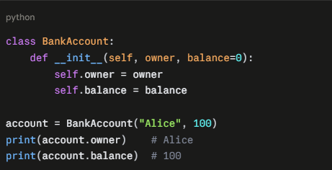
__Init__ method
When you write BankAccount("Alice", 100), Python creates a blank BankAccount object and then calls __init__ on it, passing the arguments you supplied.
What self means
self is the account being initialized. Python passes it automatically as the first argument, so you don't supply it yourself. Anything you assign to self.something becomes an attribute stored on that specific account, which is why account and another BankAccount can hold different owners and balances.

Slide 12
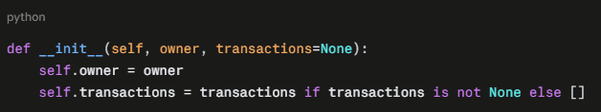
__Init__ method
Things worth knowing
__init__ must not return anything (other than None). Its purpose is to modify the object, not produce one.
It isn't technically the constructor. The object is actually created by __new__, and __init__ then initializes it. In everyday code you almost never need to touch __new__.
A class doesn't need an __init__. If you leave it out, Python uses a default one that does nothing.
Avoid mutable default arguments like def __init__(self, transactions=[]). That list is shared across all instances. Use None instead:

Slide 13
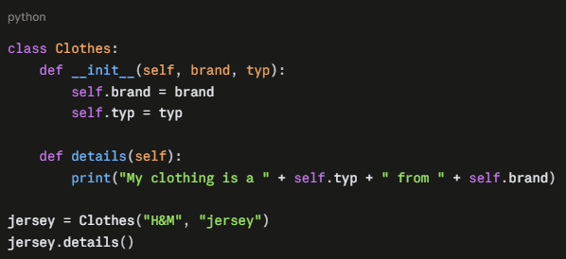
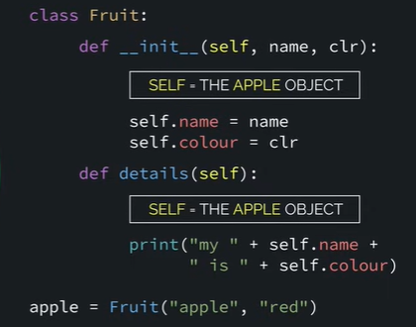
Self parameter
The self parameter is how a method refers to the specific object it was called on. It's the first parameter of every instance method, and Python fills it in automatically.

Slide 14
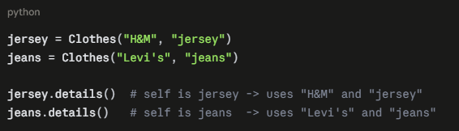
Self parameter
Why it's needed
A class is a blueprint, and you can make many objects from it. When a method runs, it needs to know which object's data to use. self is that link.

Slide 15
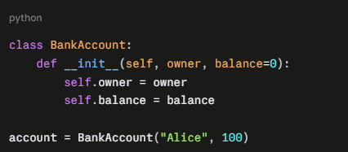
Constructor
It is a special type of method (function) which is used to initialize the instance members of the class
__init__ is a constructor method
In Python, a constructor is the process that creates and sets up a new object when you call a class, like BankAccount("Alice", 100). It involves two methods working together:
__new__ creates the blank object in memory.
__init__ then sets up its starting attributes.

Slide 16
Constructor

Slide 23
Solving Task: OOPS

Slide 29
Defining Multiple constructors in Python

